Slide 1
Python Data Science Stack

Slide 2
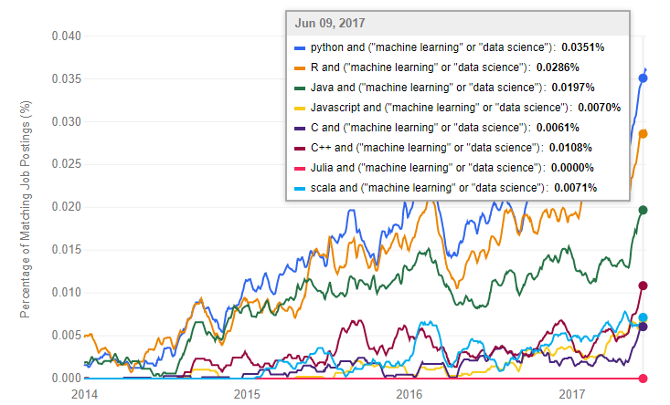
Most relevant programming languages for machine learning

Slide 3
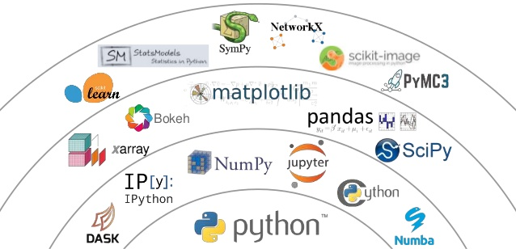


Python Data Science Stack/Ecosystem
In this course, we will focus on the most important libraries
Numpy
Pandas
Matplotlib
Scikit-learn
TensorFlow
Keras

Slide 4

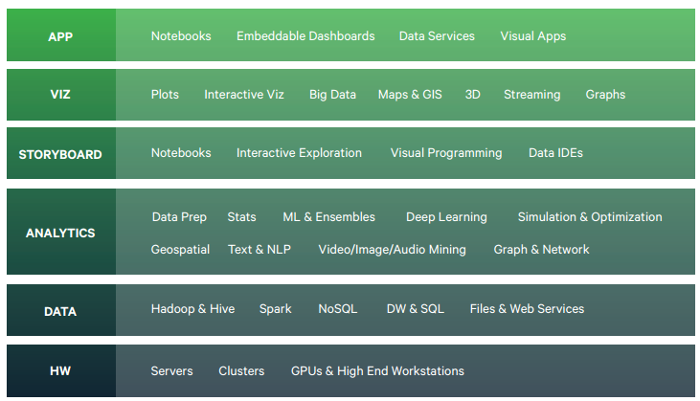
The advantage of using the Anaconda Python distribution is the functionality packed within
Anaconda is a free and open source distribution of the Python and R programming languages for data science and machine learning related applications, that aims to simplify package management and deployment. Package versions are managed by the package management system conda.
https://www.anaconda.com/distribution/

Slide 5


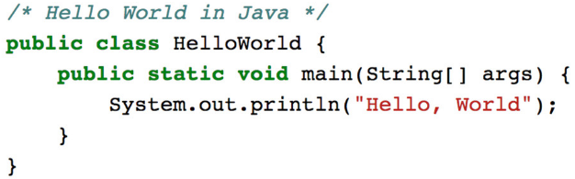
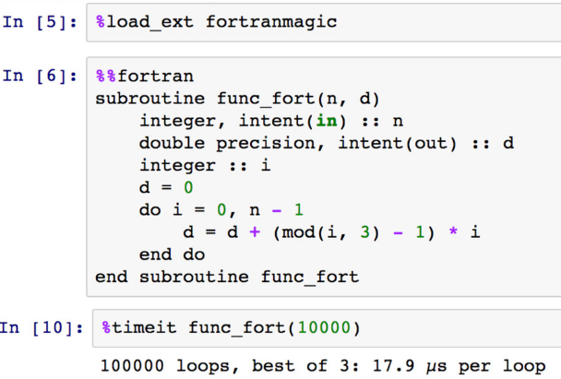
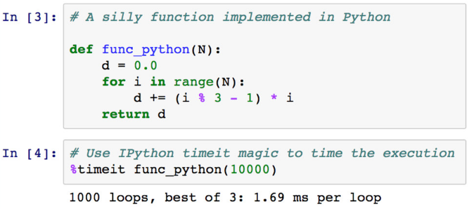
Python is fast for writing, testing and developing code
Because it is interpreted, dynamically-typed and high-level
Python is slow for repeated execution of low-level tasks
Paradox: what makes Python fast for development makes it slow for code execution

Slide 6

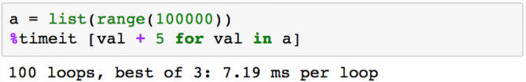
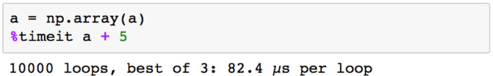
Numerical computing library designed to help us get the best of both worlds
Fast development time of Python
Fast execution time like in C
By pushing repeated operations into a statically-typed compiled layer (implemented in C)
naïve Python implementation
Numpy provides 100 times faster execution than naïve Python implementation

Slide 7

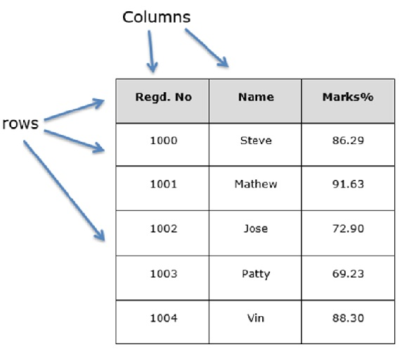
Pandas is a software library written for the Python programming language for structured data (i.e. tables) manipulation and analysis.
In particular, it offers data structures and operations for manipulating numerical tables and time series.

Slide 8
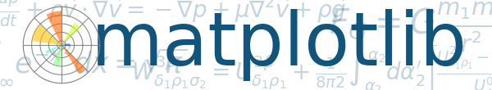
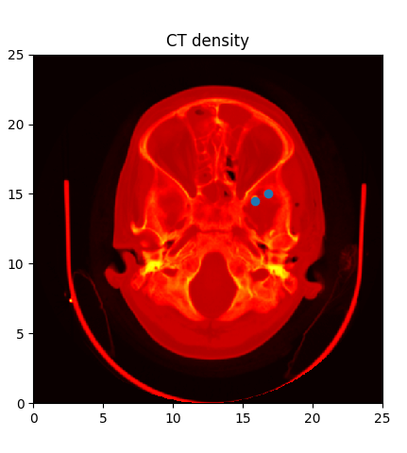
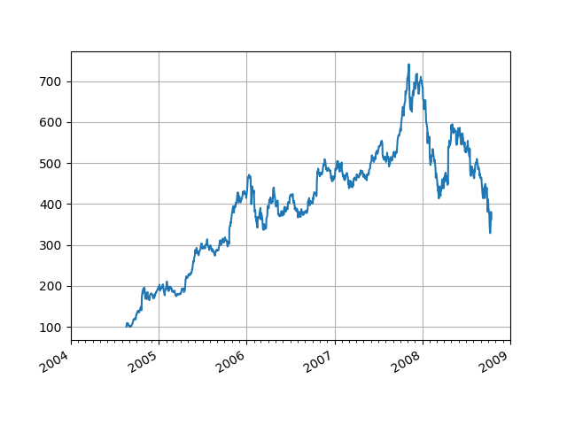
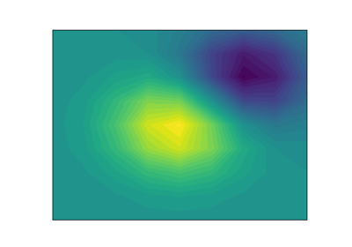
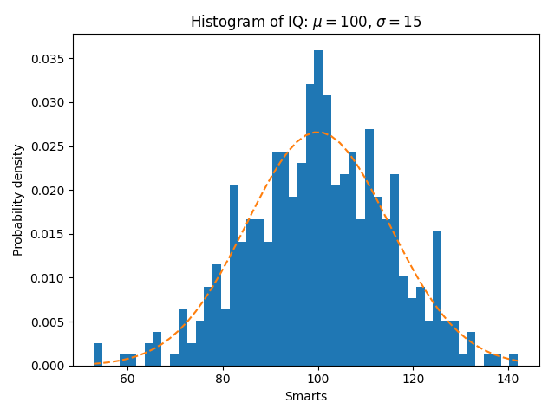
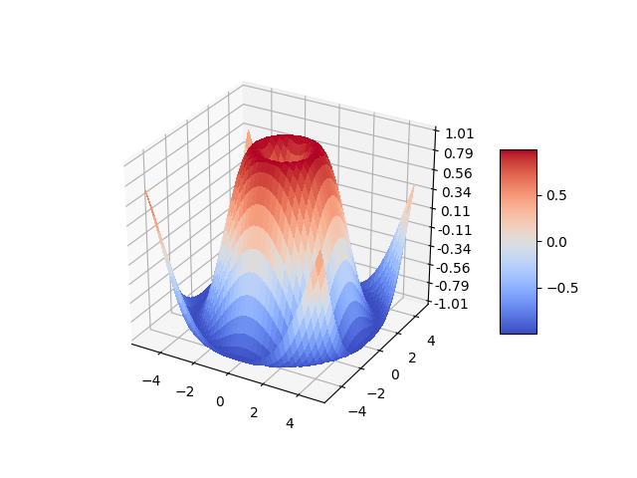
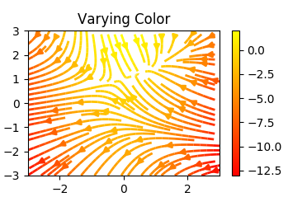
Matplotlib is a Python 2D plotting library which produces publication quality figures in a variety of hardcopy formats and interactive environments across platforms.
Matplotlib can be used in Python scripts, the Python and IPython shells, the Jupyter notebook, web application servers, and for graphical user interface toolkits.

Slide 9

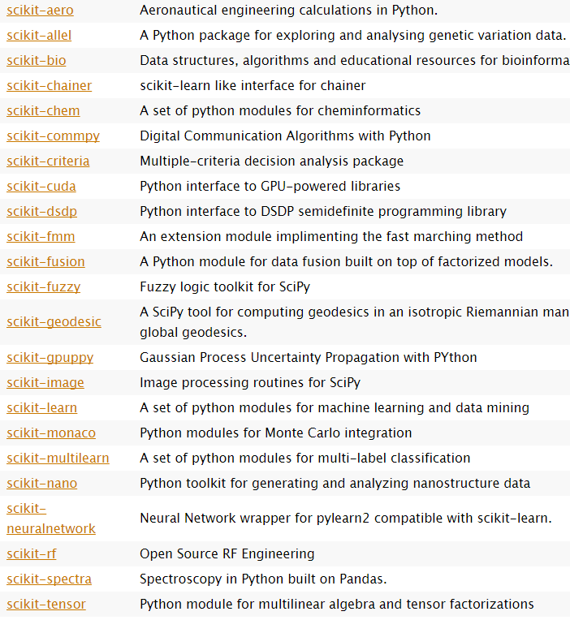
- SciPy (pronounced “Sigh Pie”) is a Python-based ecosystem of open-source software for mathematics, science, and engineering.
- SciKits (short for SciPy Toolkits), are add-on packages for SciPy, hosted and developed separately from the main SciPy distribution.
- All SciKits are available under the 'scikits' namespace
- The SciKits cover a broad spectrum of application domains, including financial computation, audio processing, geosciences, computer vision, engineering, machine learning, medical computing, bioinformatics…

Slide 10

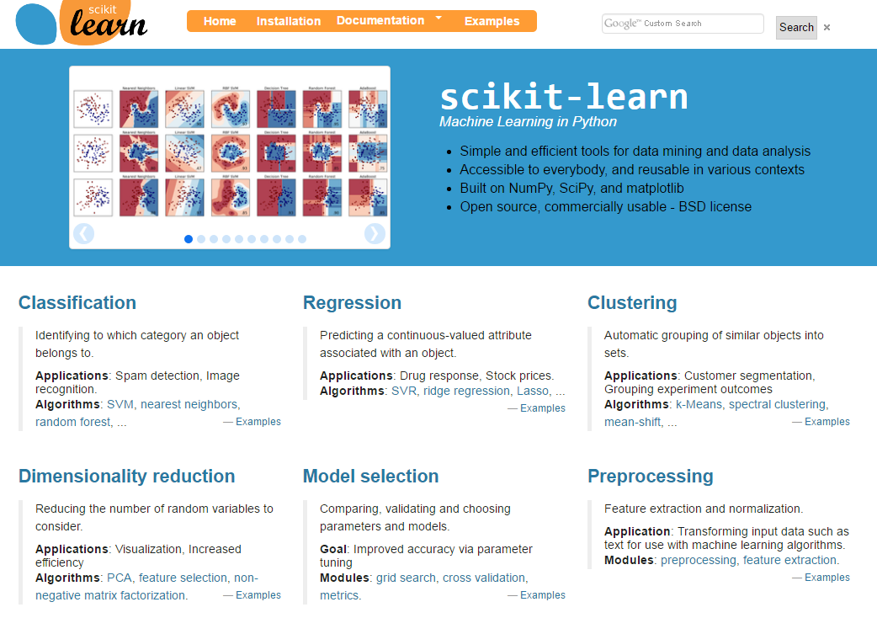
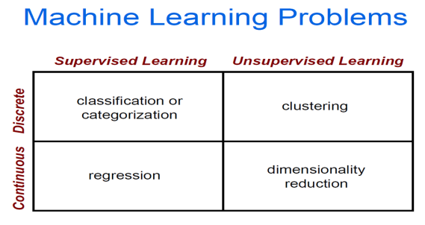
Machine learning library
Machine learning capabilities without having to hardcode the algorithms yourself
Ease of use
Simplicity and readability
Consistent interface to different ML models
A general-purpose high level language: Python
Light and easy to install package
High standards
State-of-the-art algorithms
Well Optimized
High quality bindings: performance and fine control
Open Source
BSD license
Community driven
http://scikit-learn.org/stable/
Included by default in the Python Anaconda distribution

Slide 11
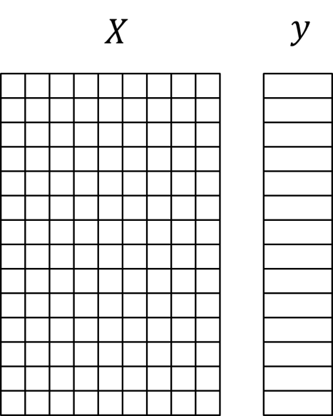
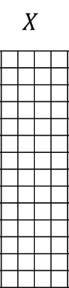
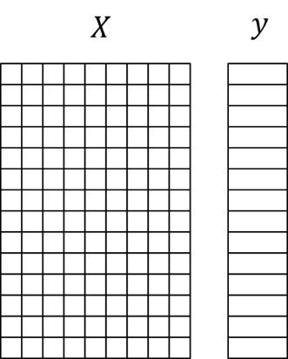
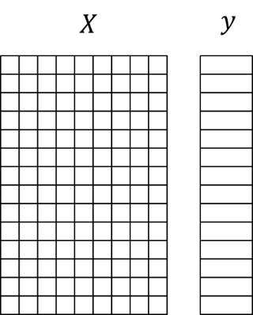
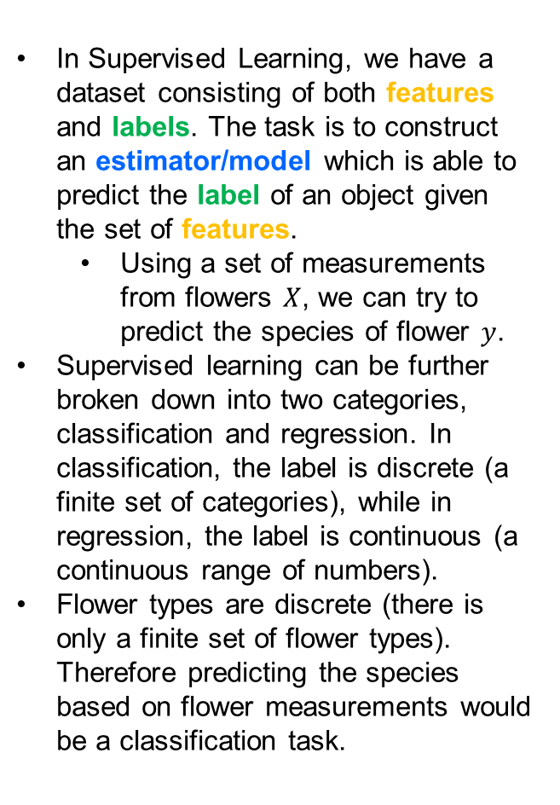
Supervised Learning Overview
In Supervised Learning, we have a dataset consisting of both features and labels. The task is to construct an estimator/model which is able to predict the label of an object given the set of features.
Using a set of measurements from flowers $X$, we can try to predict the species of flower $y$.
Supervised learning can be further broken down into two categories, classification and regression. In classification, the label is discrete (a finite set of categories), while in regression, the label is continuous (a continuous range of numbers).
Flower types are discrete (there is only a finite set of flower types). Therefore predicting the species based on flower measurements would be a classification task.
y = f(X)
Training Text, Images, etc
Machine Learning Algorithm
Labels
Test Text, Images, etc
INFERENCE STAGE
Predictive model f
Predicted Label y

Slide 12
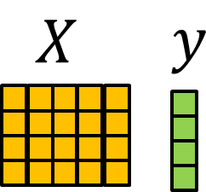
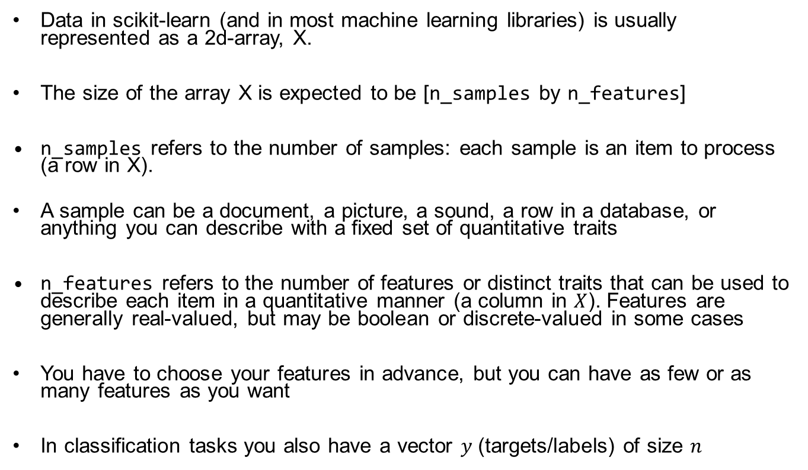
Working in scikit-learn
Data in scikit-learn (and in most machine learning libraries) is usually represented as a 2d-array, X.
The size of the array X is expected to be [n_samples by n_features]
n_samples refers to the number of samples: each sample is an item to process (a row in X).
A sample can be a document, a picture, a sound, a row in a database, or anything you can describe with a fixed set of quantitative traits
n_features refers to the number of features or distinct traits that can be used to describe each item in a quantitative manner (a column in $X$). Features are generally real-valued, but may be boolean or discrete-valued in some cases
You have to choose your features in advance, but you can have as few or as many features as you want
In classification tasks you also have a vector $y$ (targets/labels) of size $n$

Slide 13
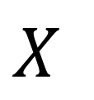
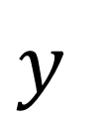

DB

Slide 14



$$X$$
$$y$$
Feature tumor size
$x1$ Tumor size

Slide 15




$$X$$
$$y$$
$x$₂ Age
$x1$ Tumor size
Feature Age

Slide 16




$$X$$
$$y$$
Instance aka
sample
$x$₂ Age
$x1$ Tumor size

Slide 17
$$X$$
$$y$$
Instance aka
sample
$x$₂ Age
$x1$ Tumor size

Slide 18
$$X$$
$$y$$
Malign
Label
$x$₂ Age
$x1$ Tumor size

Slide 19
$$X$$
$$y$$
Benign
Label
$x$₂ Age
$x1$ Tumor size

Slide 20
$$X$$
$$y$$
y = f(x)
$x$₂ Age
$x1$ Tumor size
Machine learning often involves finding a mathematical model that describes statistical patterns in the data

Slide 21






Another example
R Intensity
B Intensity
G Intensity
# Corners
# Ridges
Height
# Edges
Length
# Blobs
1.5
1
-3.6
0
-0.7
1.1
0.3
-0.1
-0.8
Dog
1.3
1.2
-1.1
0.3
-0.1
3.7
0.8
-0.5
0.5
Dog
0.3
0.5
2.2
3.4
2.3
6
1.4
5.1
0.2
Cat

Slide 22
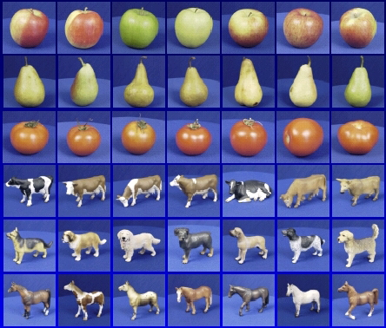


The importance of Generalization versus Memorization
Training set (labels known)
Test set (labels unknown)
How well does a learned model generalize from the data it was trained on to a new test set?
f( ) =tomato

Slide 23
Training Set
y = f(X)
In order to find the right model f, you often need to split your data into a training set from which you estimate f, and a test set where you evaluate the performance of the model f
Test
Set

Slide 24


$$X$$
$$y$$
Data pipeline
y = f(x)
Training set for model selection
X_{train} and y_{train}
Estimate/build model f
Data (X,y)
Test set for validation
X_{test} and y_{test}
Use estimated model f
Predict label/class y

Slide 25
Scikit learn consistent API interface
All objects
model.fit(X_train, y_train)
Classification, regression, clustering
y_pred = model.predict(X_test)
Evaluation
test_score = model.score(X_test)

Slide 26
Scikit learn consistent API interface – classification example
Design principles
Minimise number of object interfaces
Build abstractions for recurrent use cases
Simplicity
Code sample for classification
>>> from sklearn import svm
>>> classifier = svm.SVC()
>>> classifier.fit(X_train, y_train)
>>> y_pred = classifier.predict(X_test)
>>> accuracy= classifier.score(X_test,y_pred)

Slide 27
Scikit learn consistent API interface – regression example
Design principles
Minimise number of object interfaces
Build abstractions for recurrent use cases
Simplicity
Code sample for regression
>>> from sklearn import linear_model
>>> reg=linear_model.LinearRegression()
>>> reg.fit(X_train, y_train)
>>> y_pred = reg.predict(X_test)
>>> accuracy= reg.score(X_test,y_pred)

Slide 28

Machine learning Datasets
As an example of a simple dataset, let's look at the iris dataset which comes with scikit-learn
The Iris flower data set or Fisher's Iris data set is a multivariate data set introduced by Sir Ronald Fisher (1936) as an example of discriminant analysis (classification)
The data consists of measurements of three different species of iris flowers

Slide 29
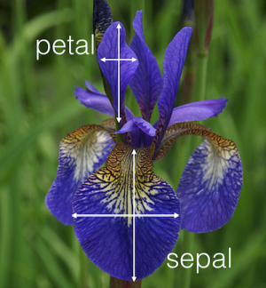
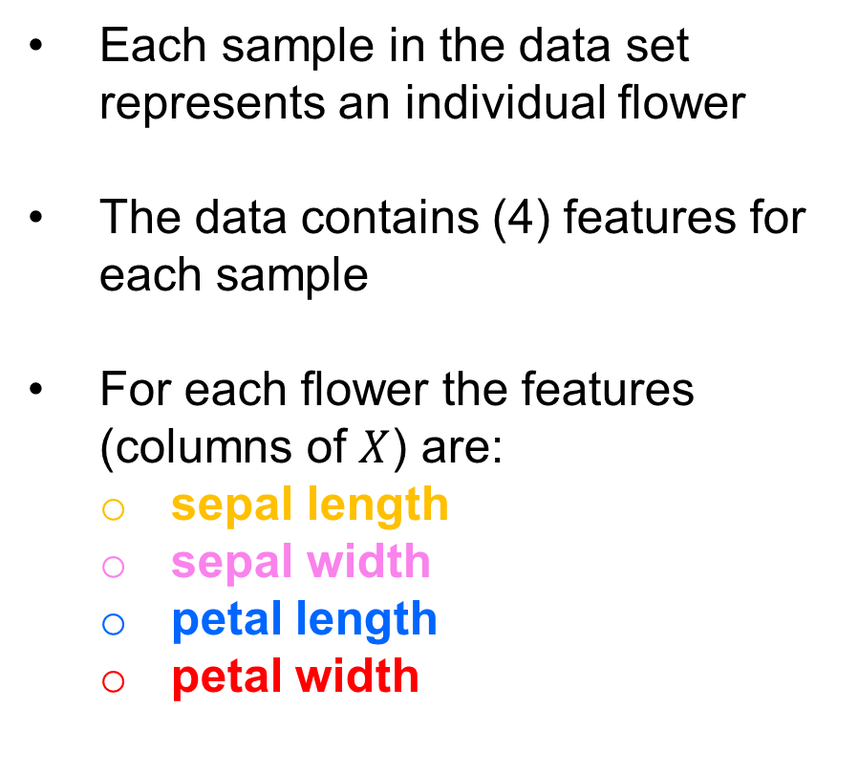


The Iris Dataset
$$y$$
$$X$$
Each sample in the data set represents an individual flower
The data contains (4) features for each sample
For each flower the features (columns of $X$) are:
sepal length
sepal width
petal length
petal width

Slide 30
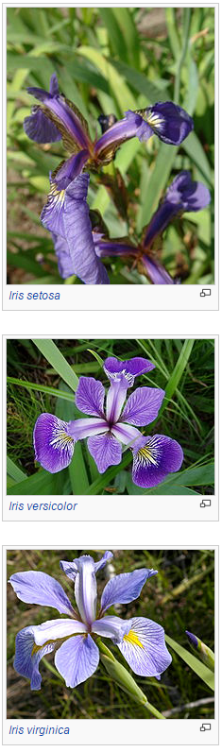
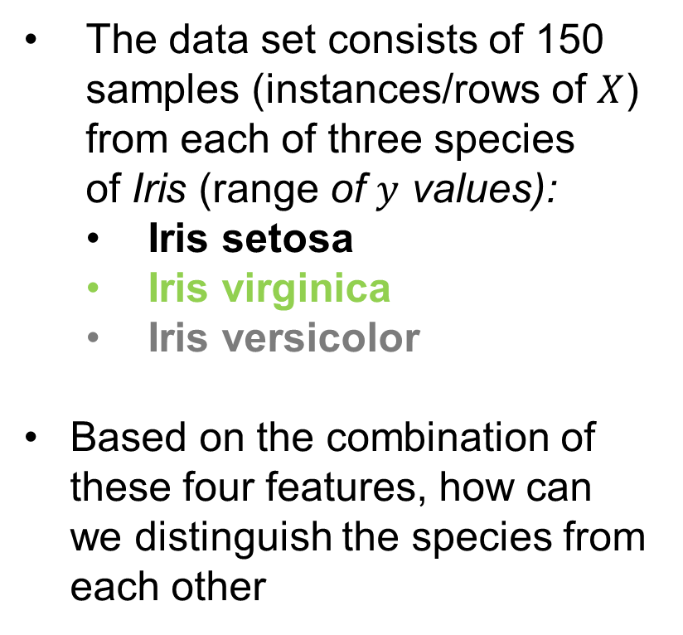


The Iris Dataset
The data set consists of 150 samples (instances/rows of $X$) from each of three species of Iris (range of $y$ values):
Iris setosa
Iris virginica
Iris versicolor
Based on the combination of these four features, how can we distinguish the species from each other
$$X$$
$$y$$

Slide 31
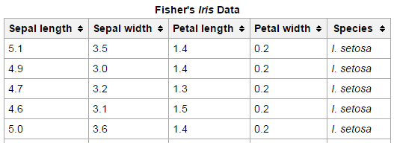
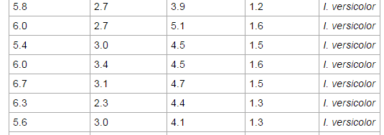
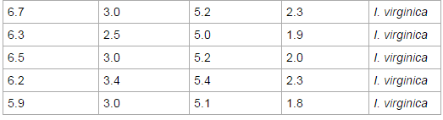
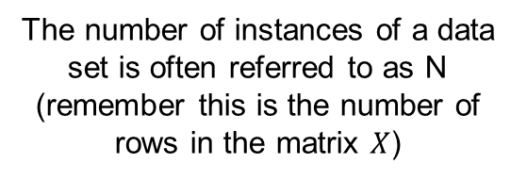


The Iris Dataset
The number of instances of a data set is often referred to as N (remember this is the number of rows in the matrix $X$)
Iris data set→N=150
$$X$$
$$y$$

Slide 32
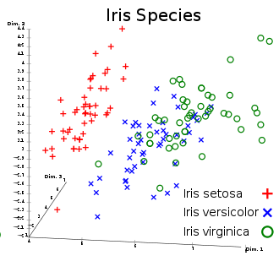
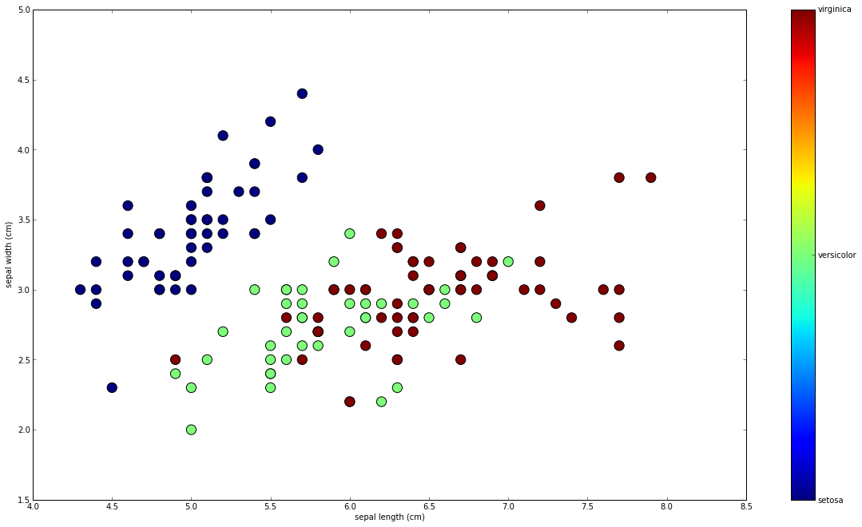
Plotting 2 and 3 of the 4 Iris Dataset features to visualize statistical structure in the data

Slide 33
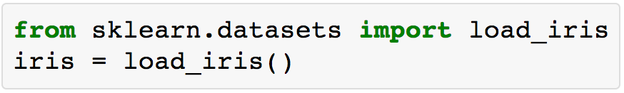
The Iris Dataset: Loading
scikit-learn embeds a copy of the iris data along with a helper function to load it into numpy arrays
If you use the Spider IDE, you can explore via GUI the Iris data structure

Slide 34

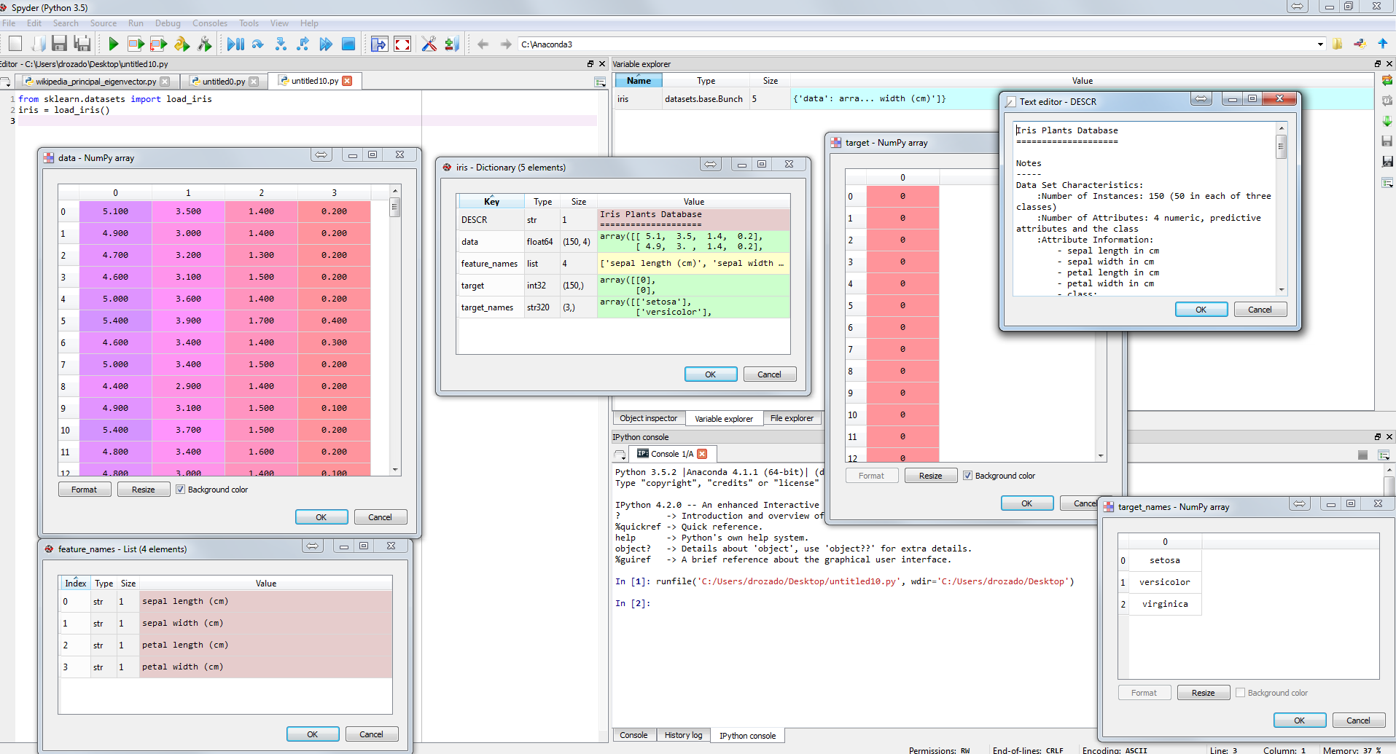
Exploring The Iris Dataset in Spyder
Spyder is an IDE for numerical computing in Python that comes embedded in the Anaconda Python distribution

Slide 35
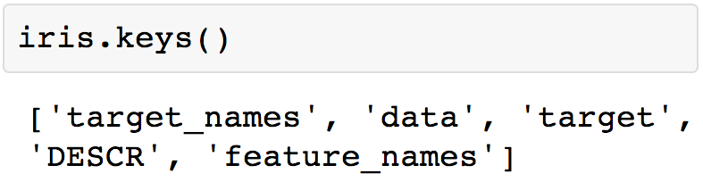
The Iris Dataset: Data structure
The resulting iris dataset is called a “Bunch” object of type dictionary
You can see what attributes are within using the method keys()

Slide 36
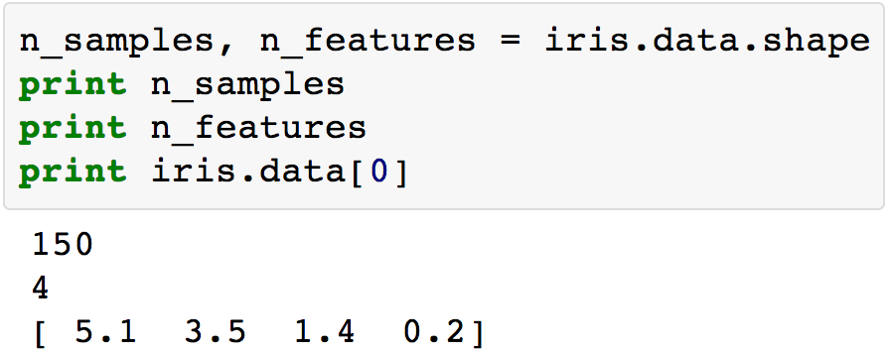
The Iris Dataset: Data dimensions
The features of the sampled flowers are stored in the data attribute of the dataset
Data is a 2d array of 150 samples (by) 4 features
Here we can see what an individual sample looks like

Slide 37
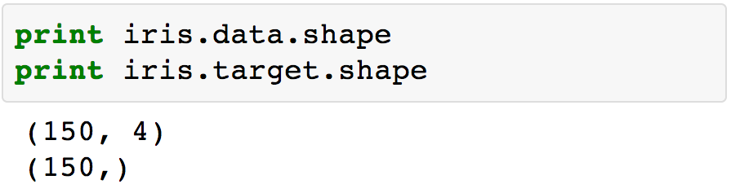


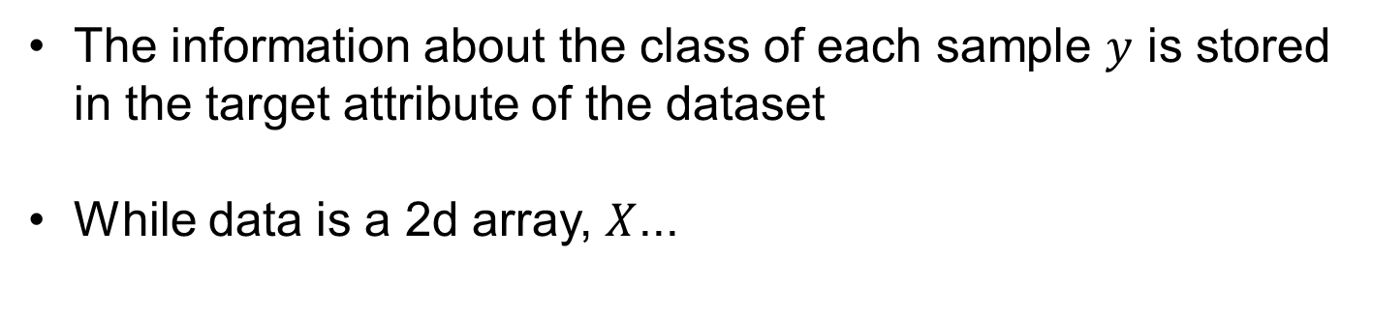
The Iris Dataset: Data dimensions
The information about the class of each sample $y$ is stored in the target attribute of the dataset
While data is a 2d array, $X$...
$$X$$
$$y$$

Slide 38
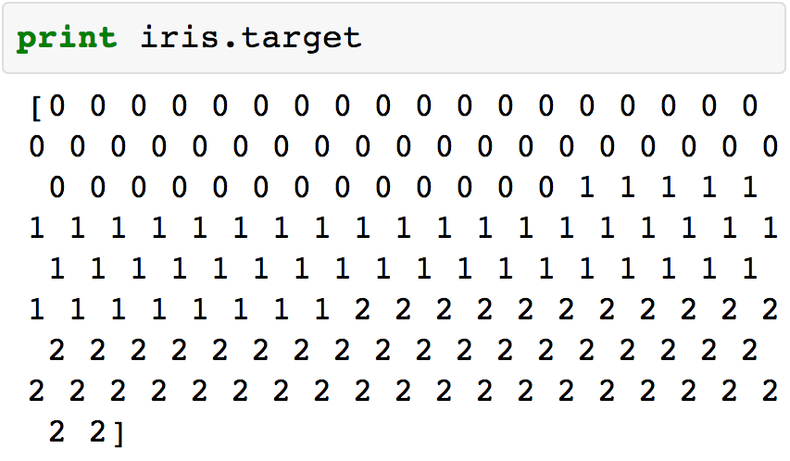
The Iris Dataset: y/target
Target is a 1d array with 1 class per sample (150)

Slide 39
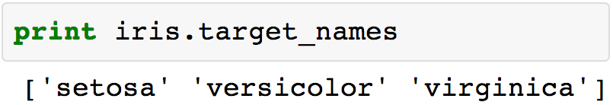
The Iris Dataset: Classes names
The names of the classes are stored in the target_names attribute. This can be used to convert the numerical target values to a human readable format

